Slide 1
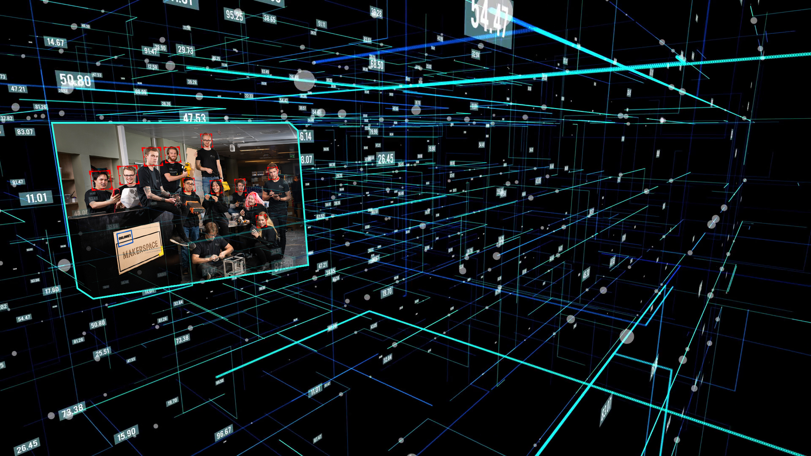
Introduction to Image Recognition
Abhijeet Sapkota
Student Mentor
@OsloMet Makerspace

Slide 2
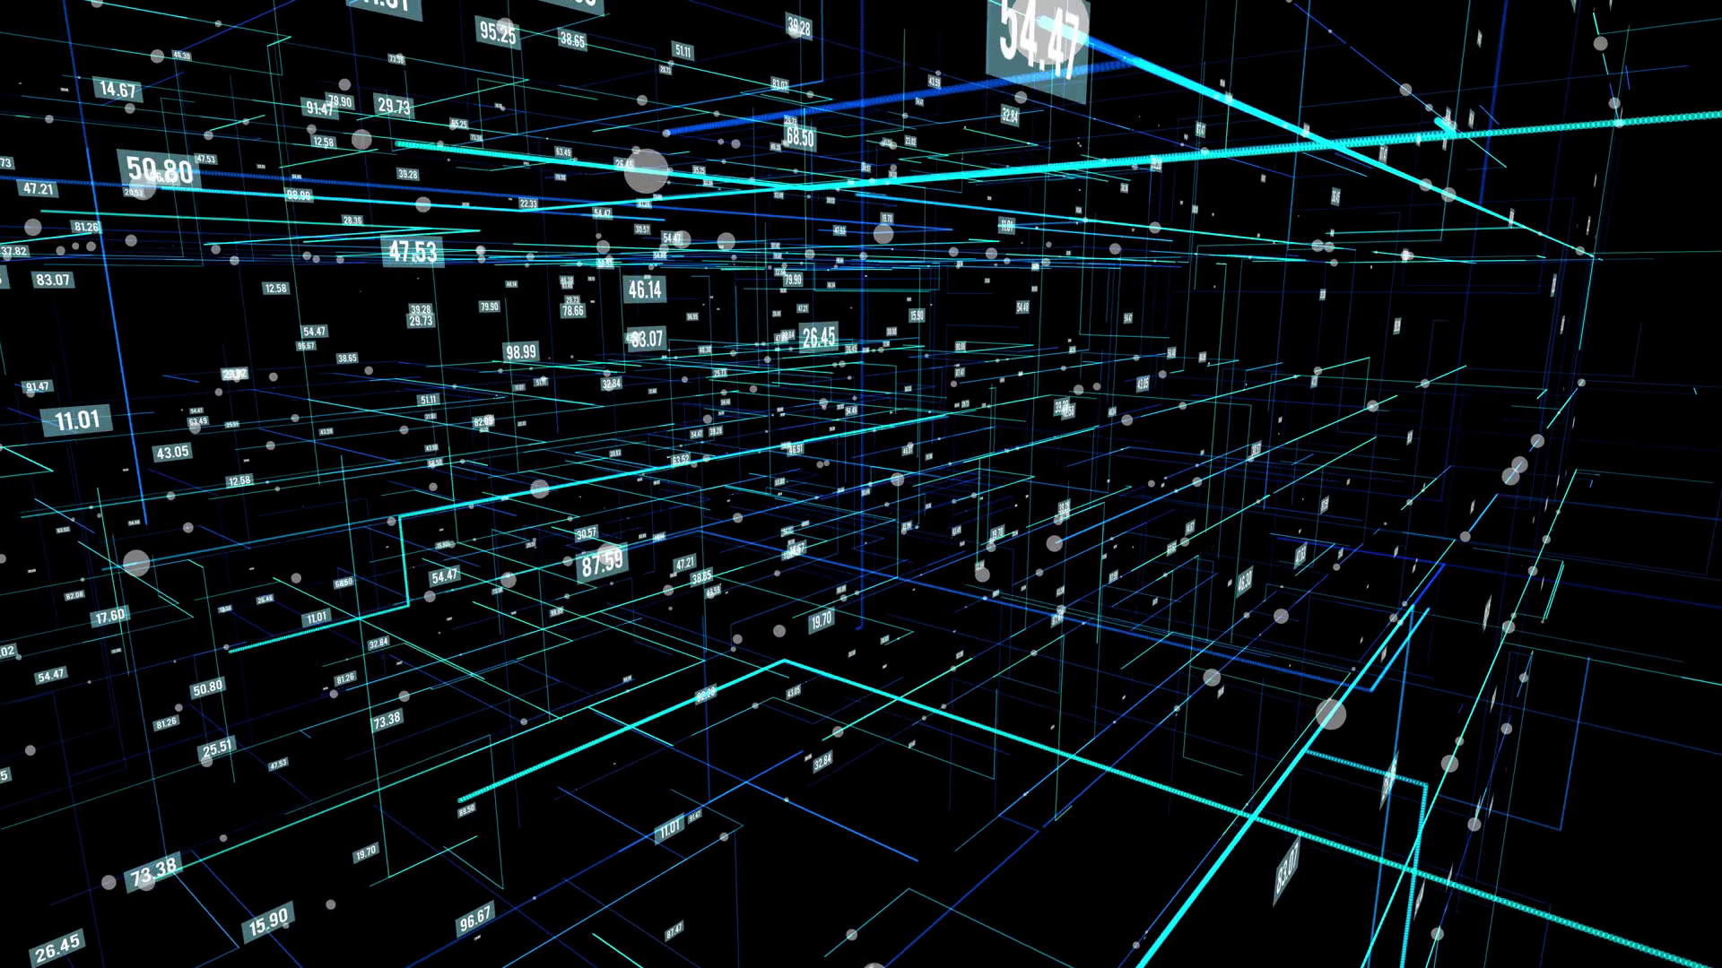
Overview
Computer Vision
Viola-Jones Haar-Feature
Installing OpenCV
Face detection
Face tracking on camera
Template matching
Github link:
https://github.com/makeriet/image-recognition
Notes:
Python Syntax (Data and Expressions)
Control Structures and Conditions
Functions
File handling

Slide 3
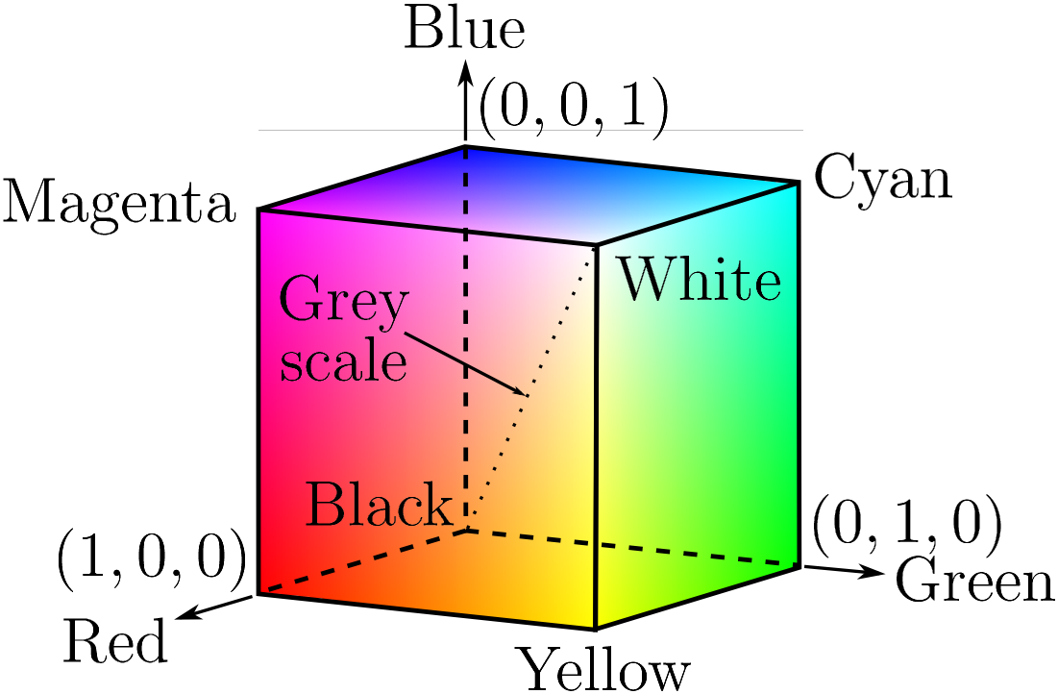
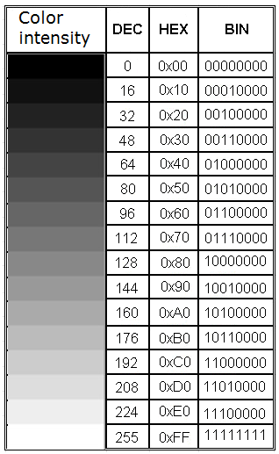
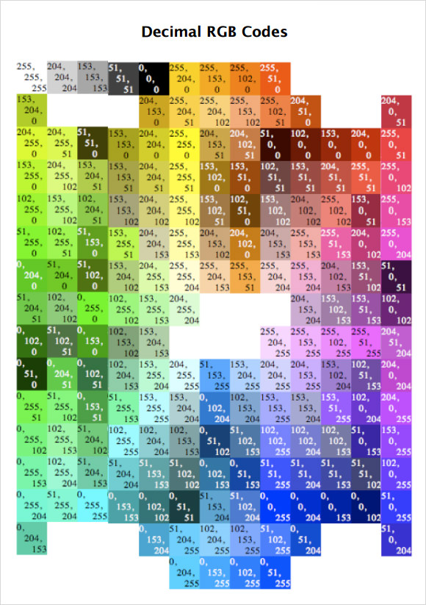
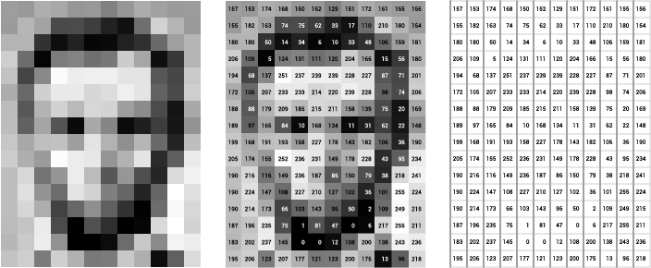
Computer Vision
255 x 255 x 255 = 16581375
R G B
12px
16px
Notes:
Python Syntax (Data and Expressions)
Control Structures and Conditions
Functions
File handling

Slide 4
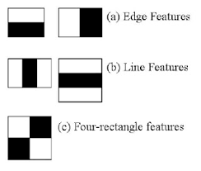
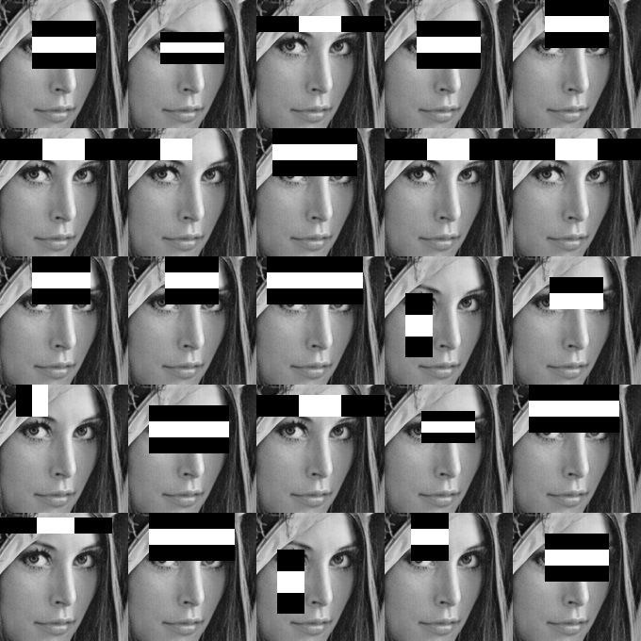
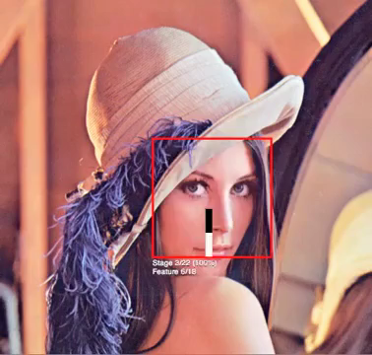
Viola-Jones Haar-Feature
algorithm used to identify objects in an image or video
proposed by Paul Viola and Michael Jones in 2001
powerful face/non-face classifiers can be constructed based on these features
they can be computed efficiently using the summed-area table or integral image technique.
Notes:
Python Syntax (Data and Expressions)
Control Structures and Conditions
Functions
File handling

Slide 5
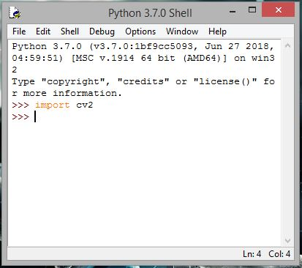
Installing OpenCV
Open “Command Prompt” in Windows or “Terminal” in Mac OS.
2. Enter the following command:
pip install opencv-python (for Python version 2)
-OR
--------------
pip3 install opencv-python (for Python version 3)
Notes:
Python Syntax (Data and Expressions)
Control Structures and Conditions
Functions
File handling

Slide 6
OpenCV classifier
Location >>>> C:\Program Files\Python37\Lib\site-packages\cv2\data
haarcascade_eye_tree_eyeglasses.xml haarcascade_mcs_leftear.xml haarcascade_eye.xml haarcascade_mcs_lefteye.xml haarcascade_frontalface_alt2.xml haarcascade_mcs_mouth.xml haarcascade_frontalface_alt_tree.xml haarcascade_mcs_nose.xml haarcascade_frontalface_alt.xml haarcascade_mcs_rightear.xml haarcascade_frontalface_default.xml haarcascade_mcs_righteye.xml haarcascade_fullbody.xml haarcascade_mcs_upperbody.xml haarcascade_lefteye_2splits.xml haarcascade_profileface.xml haarcascade_lowerbody.xml haarcascade_righteye_2splits.xml haarcascade_mcs_eyepair_big.xml haarcascade_smile.xml haarcascade_mcs_eyepair_small.xml haarcascade_upperbody.xml
Notes:
Python Syntax (Data and Expressions)
Control Structures and Conditions
Functions
File handling

Slide 7
Face detection
Import OpenCv
Read the image file
Resize picture if required
Convert image into grayscale
Initialize haar cascade feature for frontalface
Detect faces on image
Draw the rectangle around the image
Display the output image with image detected
Notes:
Python Syntax (Data and Expressions)
Control Structures and Conditions
Functions
File handling

Slide 8
Face tracking
Import OpenCv
Initialize webcam
Initialize haar cascade feature for frontalface
Create a loop to continuously read the video
Resize or flip the video if required
Convert the video into grayscale and also blur it
Detect faces in the video
Draw the rectangle around the faces in the video
Display the video with the rectangle
Release the webcam when you close the program
Notes:
Python Syntax (Data and Expressions)
Control Structures and Conditions
Functions
File handling

Slide 9
Template matching
Import OpenCv
Initialize webcam
Open a template image and get its width and height
Create a loop to continuously read the video
Resize or flip the video if required
Convert the video into grayscale and also blur it
Match image template with the blurred video
Find the area where the template is matched for maximum time
Draw the rectangle around the area in the video, where the template is matching
Display the video with the rectangle
Release the webcam when you close the program
Notes:
Python Syntax (Data and Expressions)
Control Structures and Conditions
Functions
File handling

Slide 10
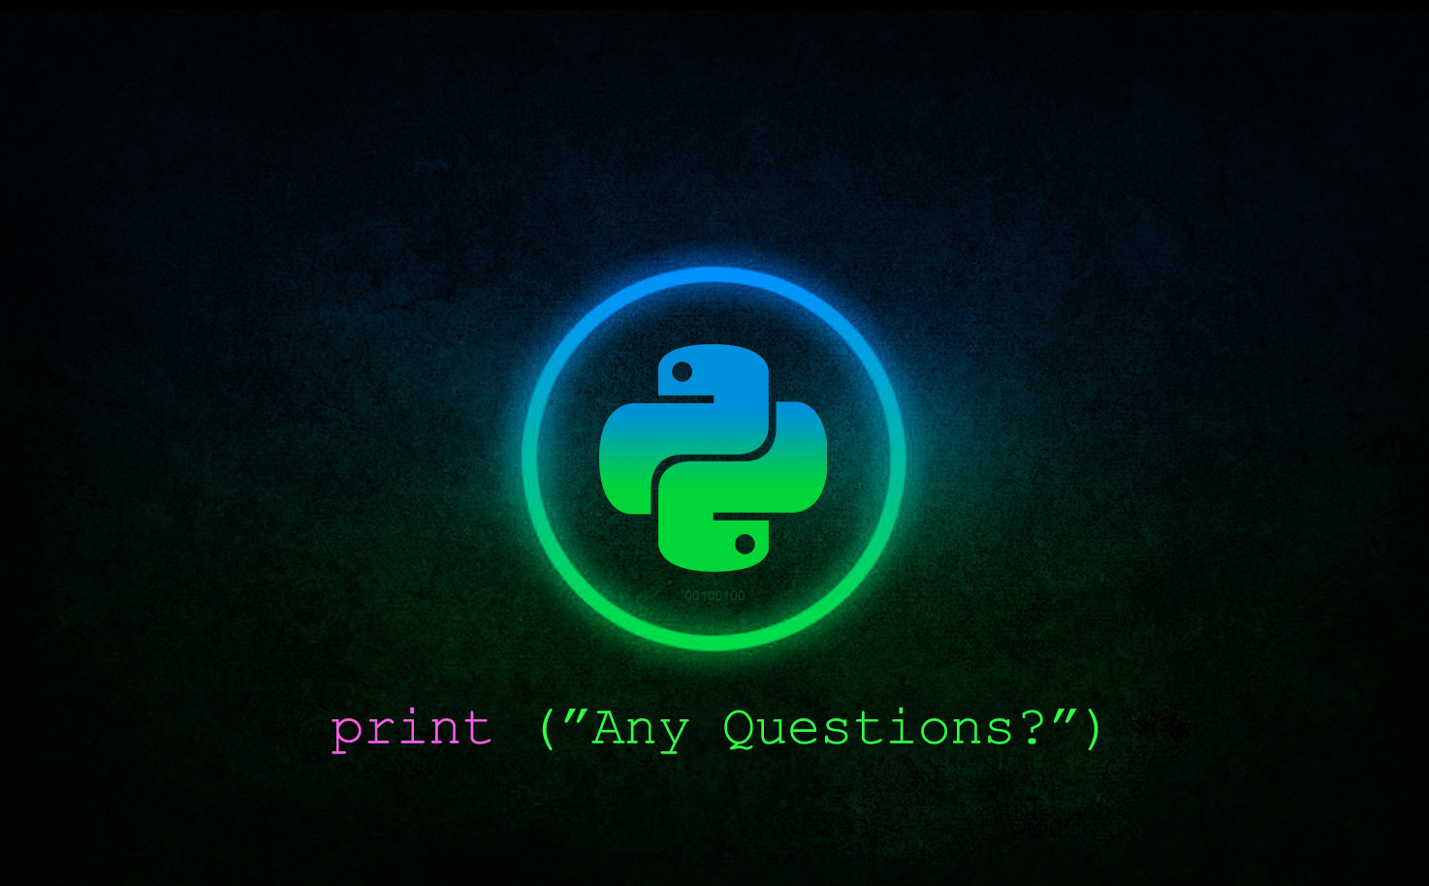


Slide 11
